Slide 1

Capstone Project final review EMOJI PREDECTION FROM SENTENCE

Slide 2
TEAM - 20
19k41A0416 - Madipelly Shashank
19K41A0503 - Bakki Sumanth
19K41A0508 - Gopagani Akshitha
Faculty :
Dadi Ramesh Sir

Slide 3
Contents
Introduction
Objectives
Dataset Insight
Pre-Processing
Literature Survey
GloVe Model
Neural Network Model
Results

Slide 4
INTRODUCTION
People use emojis every day. Emojis have become a new language that can more effectively express an idea or emotion. This visual language is now a standard for online communication, available on all social media platforms. Right now, the keyboard can predict emojis but only based on certain keywords and tags that are associated with emojis.
In this machine learning project, we predict the emoji from the given text. This means we build a text classifier that returns an emoji that suits the given text and we will do this using the Long Short-Term Memory algorithm and glove model for embedding
The trained model takes as input a sentence and finds the most appropriate emoji to be used with that sentence.

Slide 5
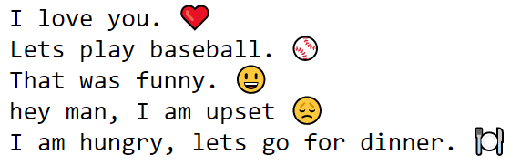
OBJECTIVE
The Main objective of our project is to predict the emoji from a given text/sentence.

Slide 6
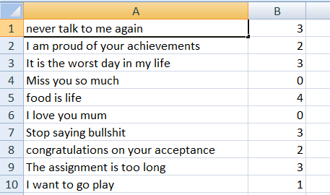
DATA SET INSIGHT
The datset which we used is downloaded from the kaggle which contains all the information regarding the emojis. Our first goal is to extract feature texts from the kaggle dataset, which will help this model to learn. The dataset contains about 316 instances of text categorized into five categories:
0: red heart,
1: baseball,
2: happy face,
3: disappointed face,
4: fork and knife with plate.

Slide 7
Literature Survey
Paper Name | Dataset used | Vector Conversion Technique used | Model Used | Result
Context-Aware emoji prediction using deep learning | This paper presents a novel dataset consisting of conversational text messages. Along with text messages, the dataset also includes the user’s location and time because it impacts the context of the message. | The methodology comprises a hybrid model that uses neural networks and score-based metrics: semantic and cosine similarity. | BERT | Our approach differs from existing studies and improves the accuracy of emoji prediction up to 73.32% using BERT
Using Neural Networks to Predict Emoji Usage from Twitter Data | We obtained a set of tweets dating from June 2016 from the Internet Archives[2]. The tweets were obtained by the Twitter Stream API | Glove embedding | Lstm-RNN CNN | 1-layer LSTM-37.2% 1-layer LSTM-GloVe-37.8% CNN – 40%

Slide 8
Literature Survey
Paper Name | Dataset Used | Vector Conversion Technique used | Model Used | Result
Multimodal Emoji Prediction | We gathered Instagram posts published between July 2016 and October 2016, dataset is composed of 299,809 posts | GloVe Embedding | ResNets FastText Bi-Lstm Baseleine | By comparing all the models used, Bi-LSTM performed well with an overall accuracy of 72%
Sentimental Analysis – Emoji Prediction | Dataset is downloaded from Kaggle | Glove Vector(GloVe) embedding | Model is created by using Global Vector (GloVe) embedding representation, combination of long short-term memory (LSTM) network and convolutional neural network (CNN) and softmax layers. | LSTM-GloVe-32.5% CNN-35.4% SVM-32.5%

Slide 9
Pre-Processing
Following are the pre-processing techniques that we used in our project
1. Removing Unnecessary columns
2. Checking for duplicate data
3.Checking for empty data
4.Converting to lowercase
5. Removing Punctuations

Slide 10
GloVe Model
Word embeddings are basically a form of word representation that bridges the human understanding of language to that of a machine. They have learned representations of text in an n-dimensional space where words that have the same meaning have a similar representation. Meaning that two similar words are represented by almost similar vectors that are very closely placed in a vector space. These are essential for solving most Natural language processing problems.
GloVe (Global Vectors for Word Representation) is an alternate method to create word embeddings. It is based on matrix factorization techniques on the word-context matrix. A large matrix of co-occurrence information is constructed and you count each “word” (the rows), and how frequently we see this word in some “context” (the columns) in a large corpus. Usually, we scan our corpus in the following manner: for each term, we look for context terms within some area defined by a window-size before the term and a window-size after the term. Also, we give less weight for more distant words.

Slide 11
Neural network MODEL
LSTM :
In our project we are using LSTM Model for training an emoji classification model as LSTM can extract the context of the text message. Feasibility-wise, the use of both textual features and numerical features for classification is possible with the LSTM model.
Long Short-Term Memory (LSTM) is a deep learning model that can process sequential data due to its architecture containing gates for the flow of information and a cell for remembering data points.
This model is beneficial for NLP tasks as it can remember the sequence of data which is crucial for language-based models.
For Embedding we have used the Glove Model(100d).

Slide 12
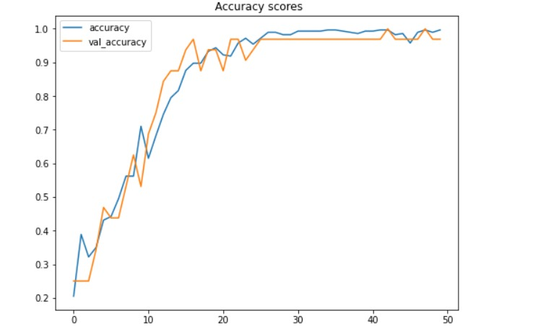
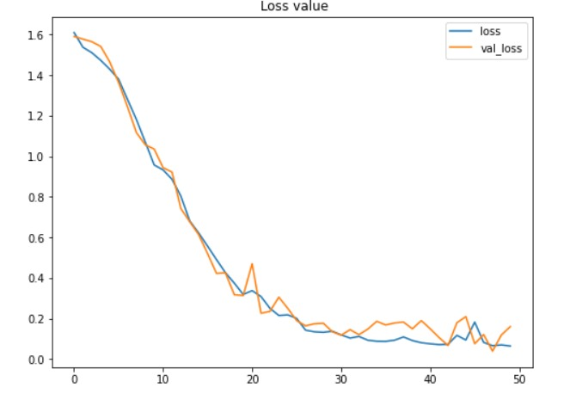
Results
For prediction of emoji from a given sentence, we implemented a Long Short-Term Memory (LSTM) model. The LSTM model predicted the emoji with an overall accuracy of 99.33%.
Following are the graphs of Accuracy and Loss.

Slide 13
THANK YOU

